Slide 1

SELF CHECKOUT cart
Saicharan Vustepalli
Team: Super Kings
8179649711
Lovely Professionl University

Slide 2
Problem Statement:
Design A Self Checkout Cart (Smart Shopping Cart) ?

Slide 3
Solution Approach:
Using “RFID” Tags to every item, we can get the solution to the Problem ….

Slide 4
Technology Used:
Using (IOT) Internet of Things Technology we can get solution

Slide 5
Hardware Specifications:
RFID Tags and Scanner
LED Screen
Trolly with Battery

Slide 6
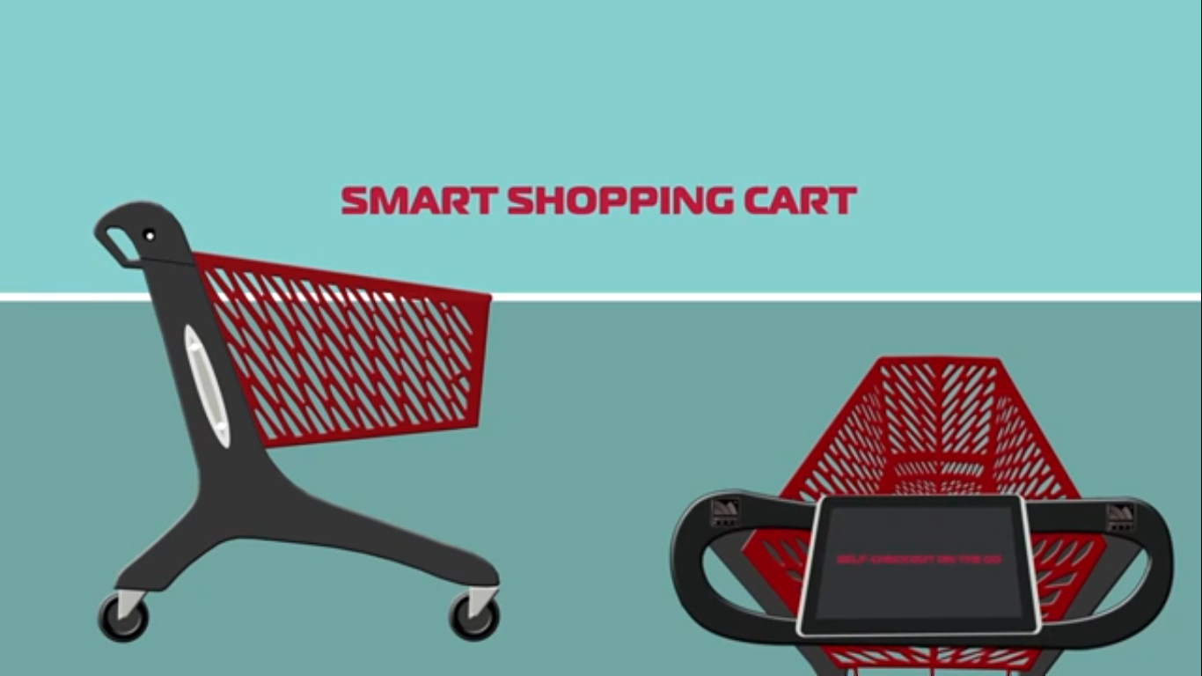

Slide 7


Slide 8
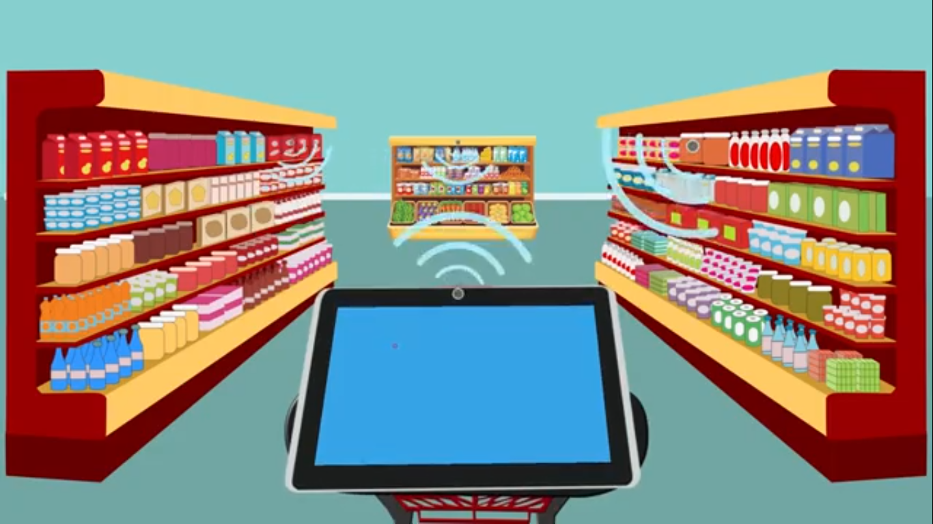

Slide 9
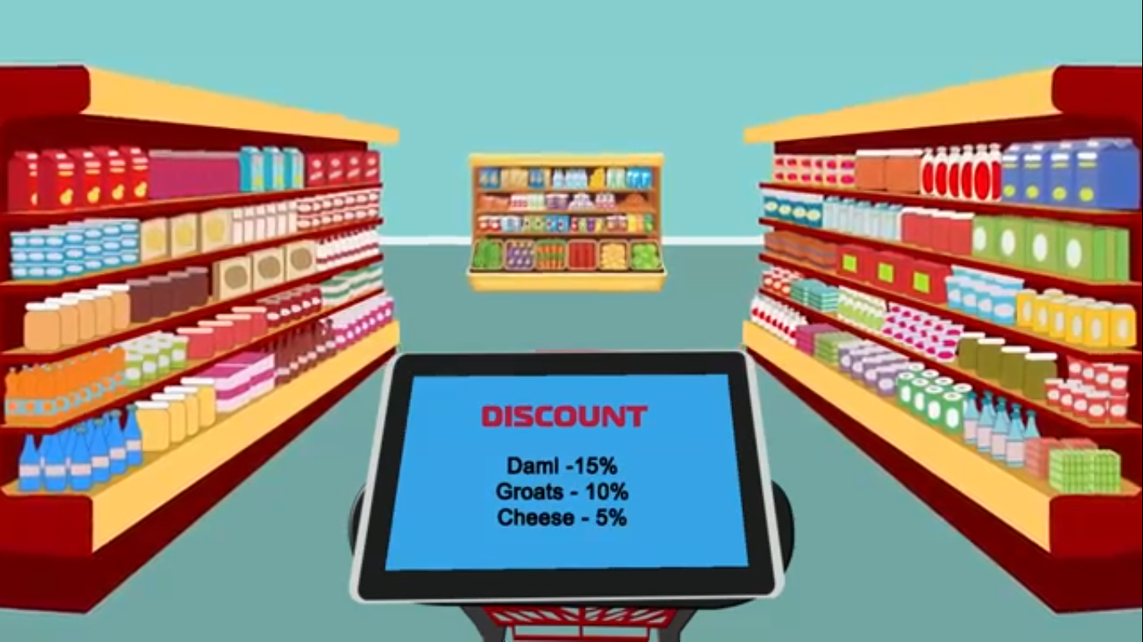

Slide 10
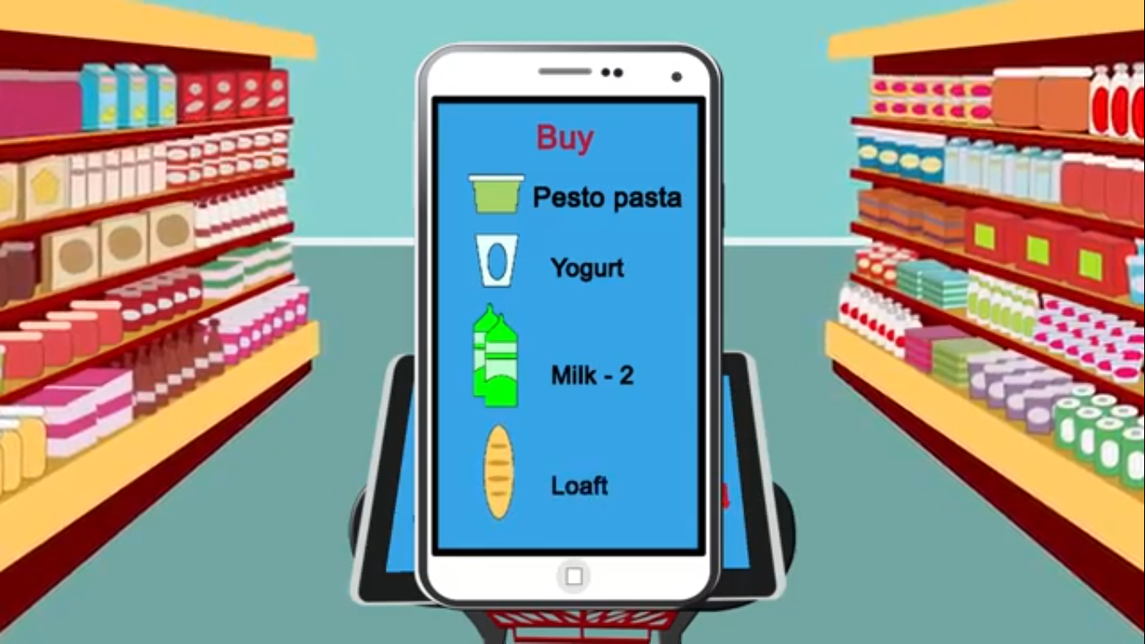

Slide 11


Slide 12
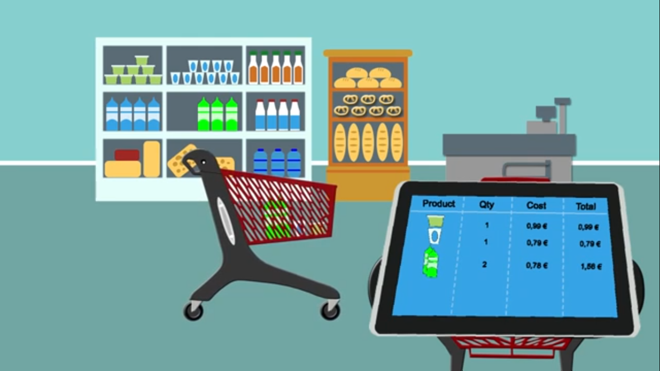

Slide 13
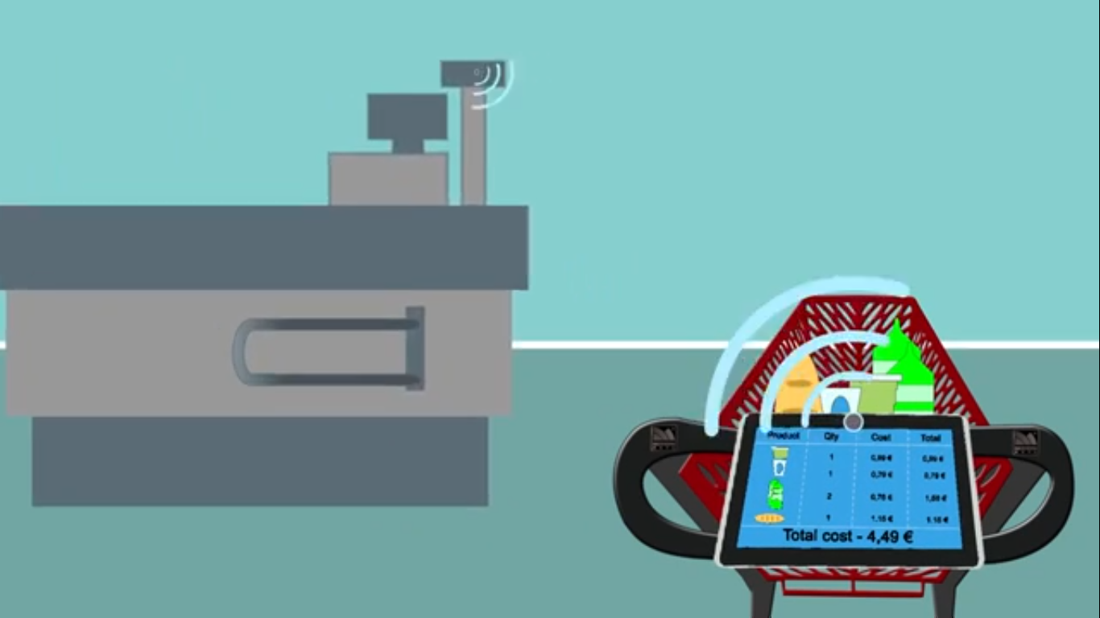

Slide 14
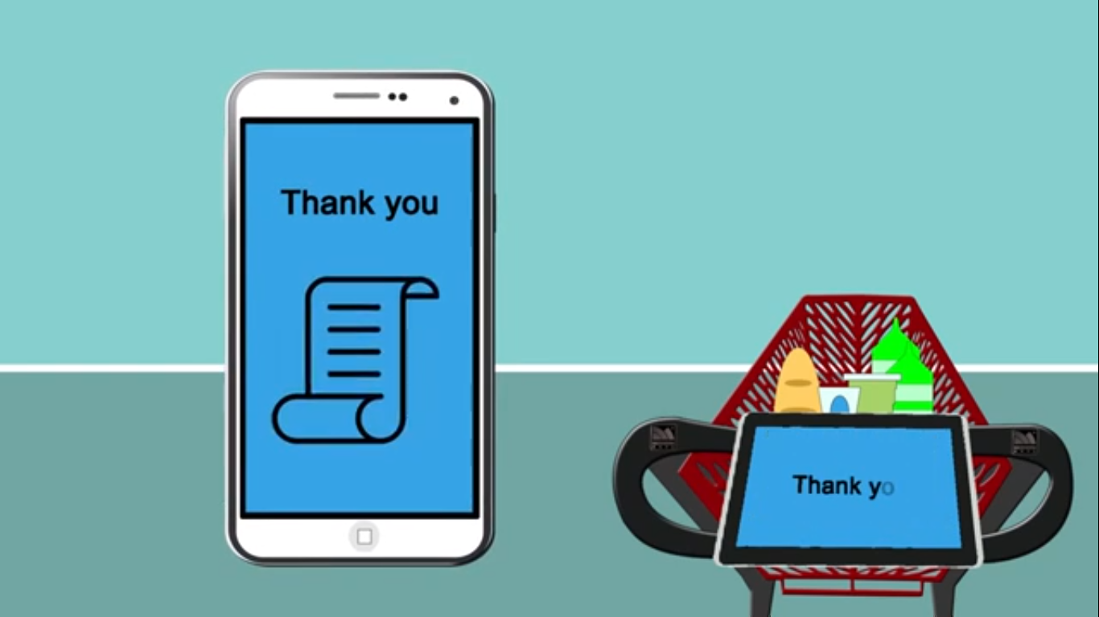

Slide 15
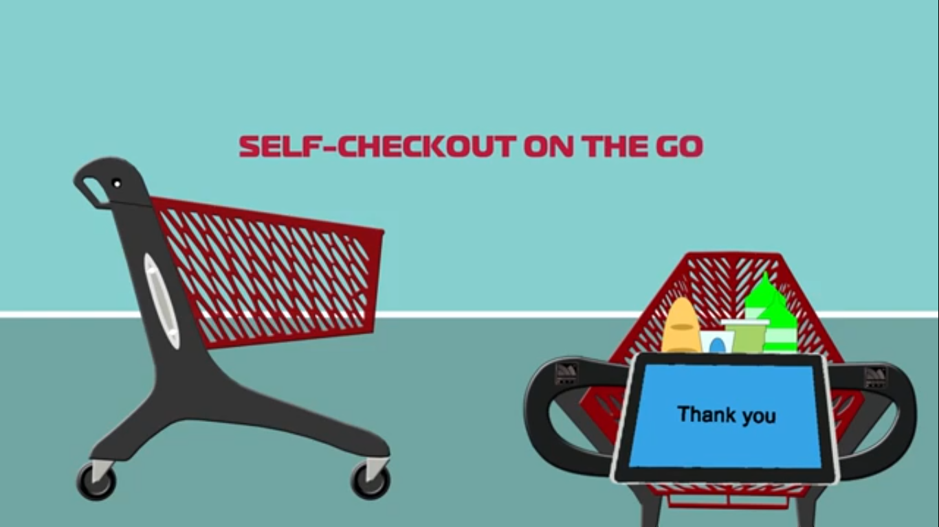

Slide 16
Challenges Faced:
Making the Project Cost Effective is the main challenge faced.
Using RFID the project can be Cost Effective.
Ease of use of the Product is another challenge faced.

Slide 17
THANK YOU

